Slide 1
Directors’ Club Promotion of Active Employment Policy Measures Belgrade, 25/09/2016
Hungary

Slide 2
Current trends
Hungary is the world’s seventh most popular investment destination, according to the latest report for 2017 by IBM Global Location Trends.
In Q2 2018, Hungary’s GDP grew by 4.8 percent year-on-year (MoF)
In June 2018, average gross earnings amounted to HUF 329,600, 11.2% higher than a year earlier (HSCO)
April–June 2018, the average number of unemployed people was 165 thousand, 3,6% (HSCO)

Slide 3
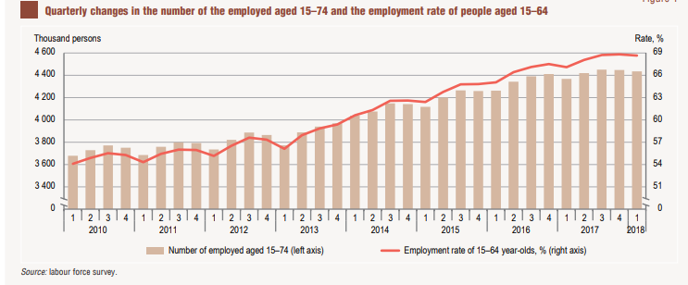
Employment

Slide 4
Structure of the education system

Slide 5
VET
1st Is part of the school system (schooling is compulsory till the age of 16)
Two different types: vocational trade school and vocational grammar school
Since May 2018, responsibility for more than 300 Vocational Education and Training (VET) schools that train around 200,000 students has been gradually transferred to the Ministry for Innovation and Technology,
2nd there is a new Adult Education Act (2013)
3rd there are CPD set by law for certain professional groups (teachers, civil servant, doctors, social workers etc.)
4th as part of the HiED (2011)
5th the PES remains under the control of the MoFinance, territorial units supervised by the PM’ Office,
ALMP: described by the Employment Act (1991, 1996)
Programmes are delivered by the PES
OP based programmes

Slide 6
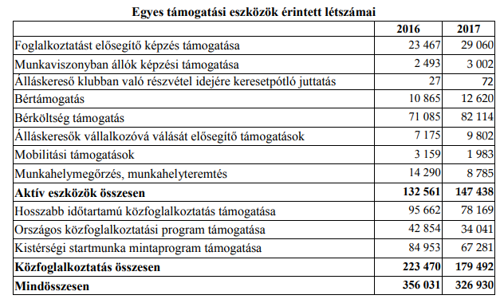
VET under the PES
Training for employed (preventive)
Training for unemployed /registered job-seekers
No PES own infrastructure
Private providers or
State VET Centres (44)
Dual trainings

Slide 7
Responsibilities
MoIT
New Skills Councils
Runs the State VET Centres (44)
Responsible for the NQR
MoF
Hosts the National Competitiveness Council
Supervise the National Employment Fund and employment related OP planner
Runs a pilot of the PES (McKinsey)
PM’ Office
Responsible for the territorial administration, incl. PES
as a Contracting body for ESF etc.
MofHR
Responsible for the school system and HiED
Plans and supervises social inclusion and youth polices

Slide 8
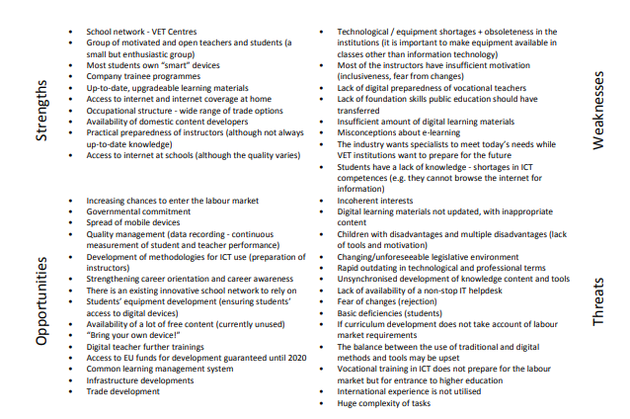
Reform plans
Digital Education Strategy (2016)
Digital Labour Market Plan (2017)
New role for Skills Councils in order to redesign the NQR
McKinsey pilot of the PES, MoF (2018)

